Slide 1

Convolutional Neural Network (CNN)
INDEX
Brief History
How to Work
Paper
연세대학교 정보대학원 조 인제

Slide 2

WHY?

Slide 3
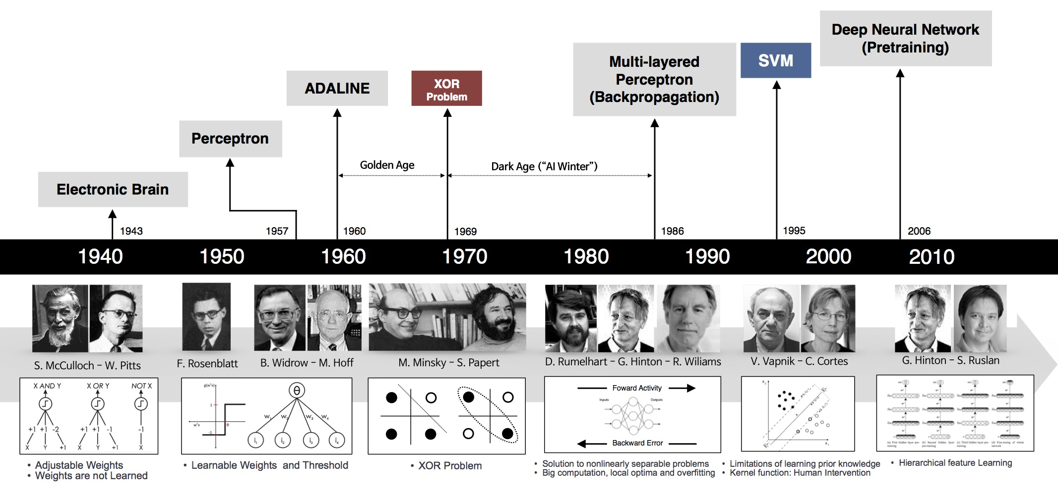

Convolutional Neural Network : Brief History
1940s
1986
We can make Multi Layer Neural Network!
1969
https://www.slideshare.net/deview/251-implementing-deep-learning-using-cu-dnn/4

Slide 4

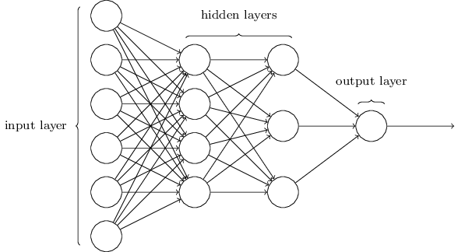
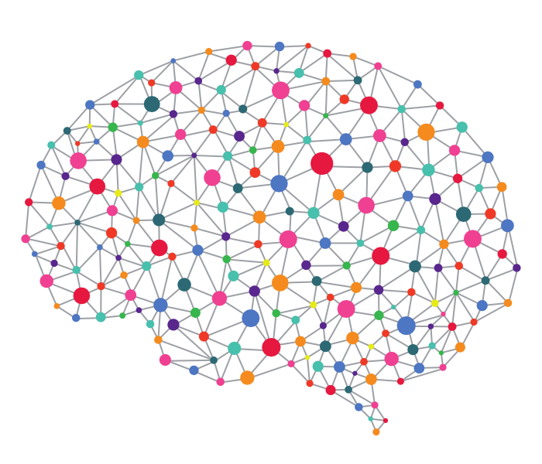
Convolutional Neural Network : Brief History
Visual Recognition & Neural Network
영상 인식에 NN을 적용

Slide 5
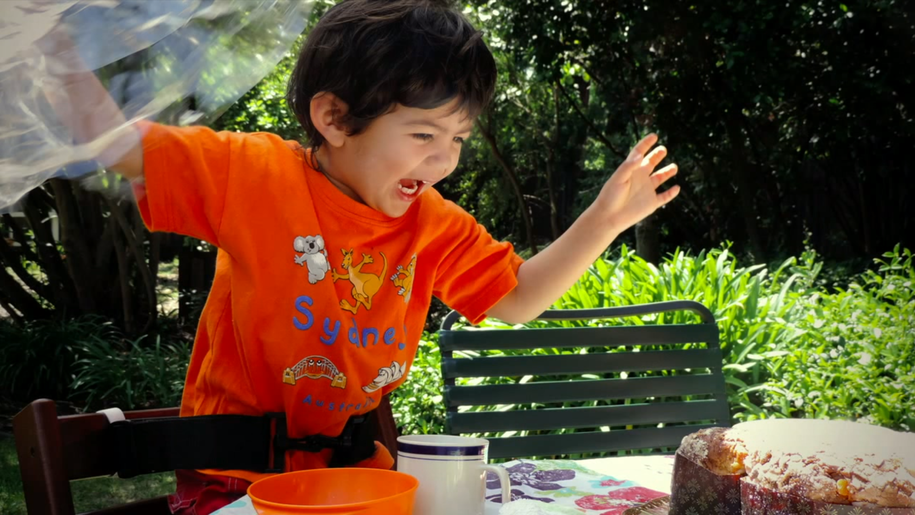
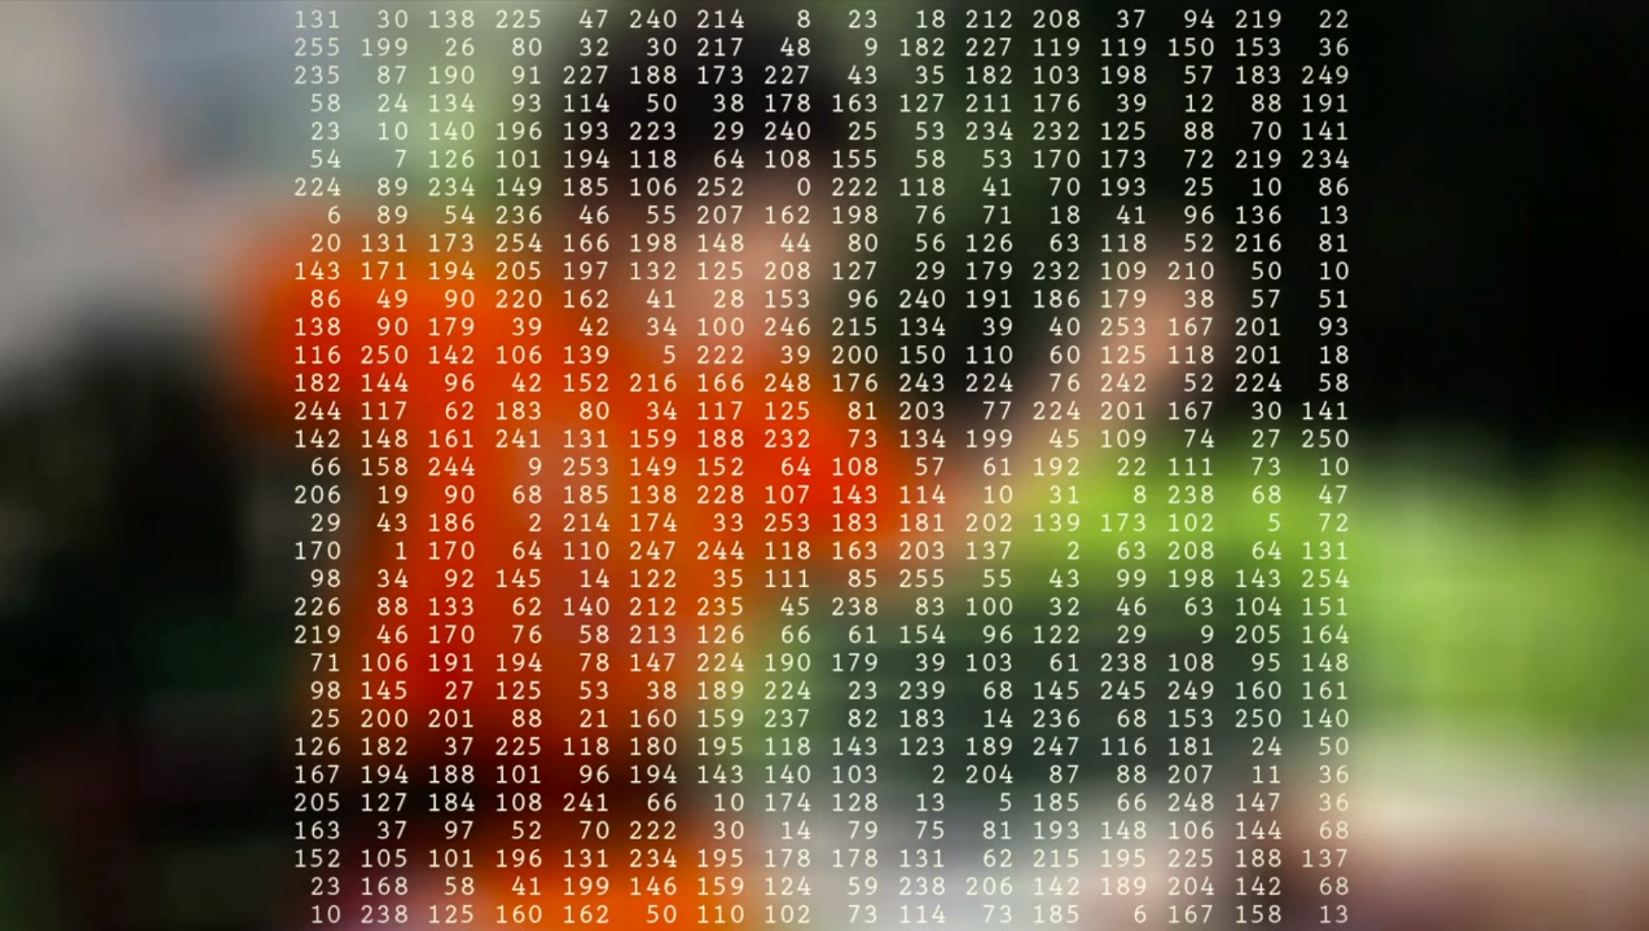
https://www.ted.com/talks/fei_fei_li_how_we_re_teaching_computers_to_understand_pictures?language=ko

Slide 6
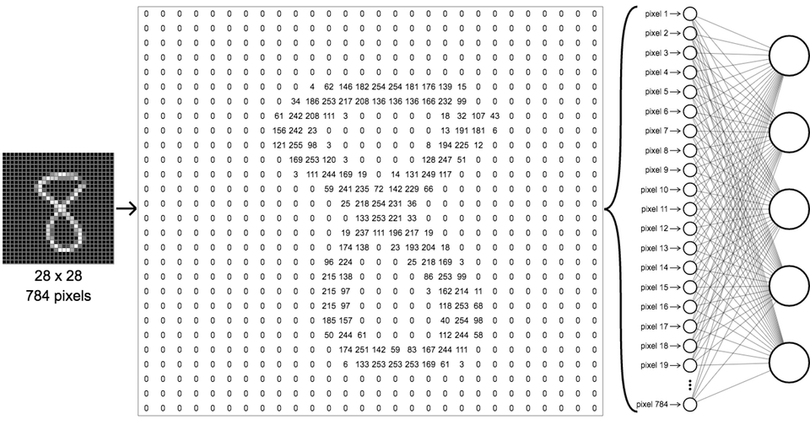
Convolutional Neural Network : Brief History
Example Handwritten Digit Number
Problem 1 : Too Many Parameters!
Input Node 28X28 = 784
If 2 Hidden Layer & 100 node 784 X 100 + 100(Bias) = 78,500 100 X 100 + 100(Bias) = 10,100
Output Layer = 10 node
100 X 10 + 10(Bias) = 1010
Total 89,610 Parameters !
0~255 Real Number
https://ml4a.github.io/ml4a/neural_networks/

Slide 7
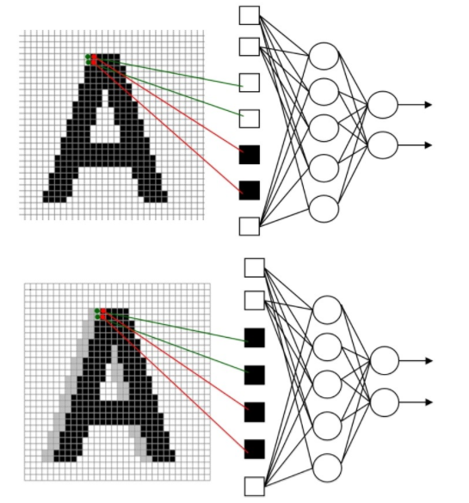
Convolutional Neural Network : Brief History
Example Handwritten Digit Number
Problem 2 : Ignore Topology
Sensitive to Distortion, Scale, Shift 이미지의 크기, 이동, 변형에 따라 민감 해당되는 새로운 학습데이터를 추가 (이에 따라 좋은 성능이 나오지 않음)
http://blog.naver.com/PostView.nhn?blogId=laonple&logNo=220587920012&parentCategoryNo=&categoryNo=22&viewDate=&isShowPopularPosts=true&from=search

Slide 8

INSPIRATION

Slide 9
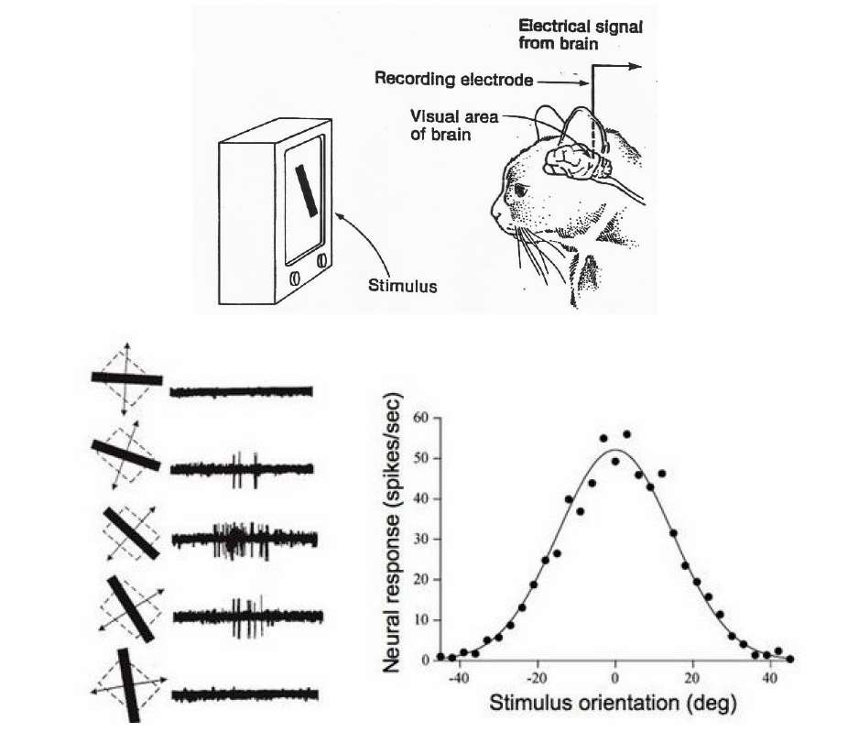
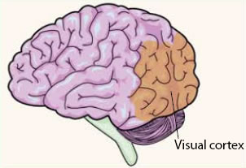
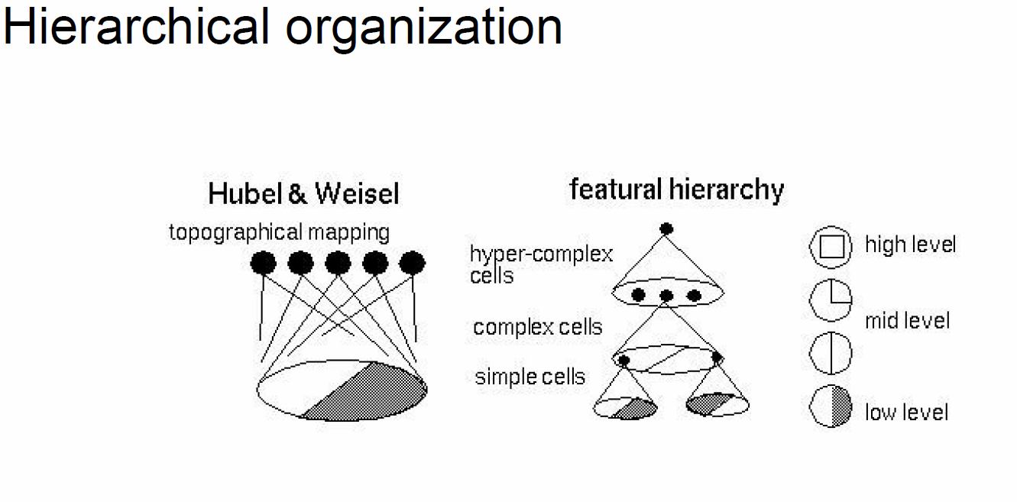
Convolutional Neural Network : Brief History
Biological Inspiration
Hubel & Wiesel in 1959
CNN Biological Inspiration from Visual Cortex
visual cortex of the brain is a part of the cerebral cortex(대뇌 피질) that processes visual information. (reference : https://en.wikipedia.org/wiki/Visual_cortex)
some neurons fired when exposed to vertical edges
some individual neuronal cells in the brain responded (or fired) only in the presence of edges of a certain orientation. 실험을 통해서 특정 방향의 특징에만 반응하는 세포영역이 있음을 밝혀 냄.
Hubel and Wiesel found out that all of these neurons were organized in a columnar architecture and that together, they were able to produce visual perception. 특정 방향의 특징에만 반응하는 낮은 수준의 세포영역들이 둥근 형태로 형성, 이들이 계층적 구조를 통해서 더 높은 차원의 특징을 인지하게 됨.
http://cs231n.stanford.edu/slides/2016/winter1516_lecture7.pdf

Slide 10
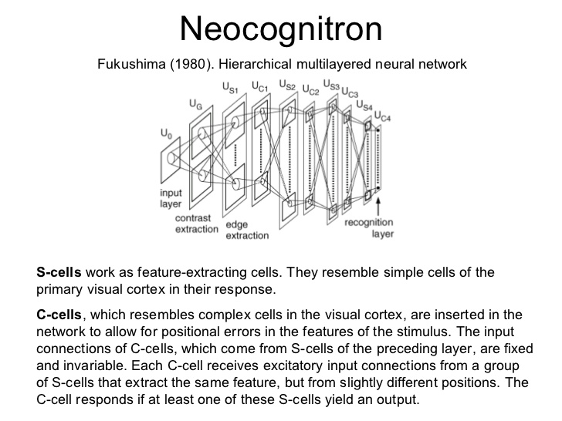
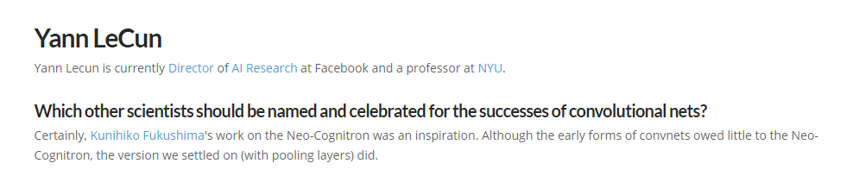
Convolutional Neural Network : Brief History
Neocognitron
Fukushima in the 1980s
The neocognitron was inspired by the model proposed by Hubel & Wiesel in 1959. Hubel & Wiesel의 실험에 의해 고양이의 시각인식이 계층적 구조로 낮은 수준의 세포영역들의 결합으로 점차 높은 수준의 특징을 인지할 수 있는 구조에 영감을 얻음.
특징을 추출하는 S-Cell, 특징들의 위치 오류를 허용하는 C-Cell 이 두가지 cell들이 교대로 배열.
Neocognitron은 많은 셀들로 이루어진 층들이 여러 개 모여 구성된 계층적 네트워크, 학습에 의하여 패턴을 인식할 수 있는 능력을 획득
http://www.aistudy.com/neural/cognitron_kim.htm#_bookmark_9e0720
Yan Lecun의 LeNet-5(1998)와 매우 유사한 구조를 지내고 있음. 실제 Lecun의 Interview Fukushima의 연구에서 영감을 얻었다고 말함.
http://blog.kaggle.com/2014/12/22/convolutional-nets-and-cifar-10-an-interview-with-yan-lecun/
http://www.cs.princeton.edu/courses/archive/spr08/cos598B/Readings/Fukushima1980.pdf

Slide 11
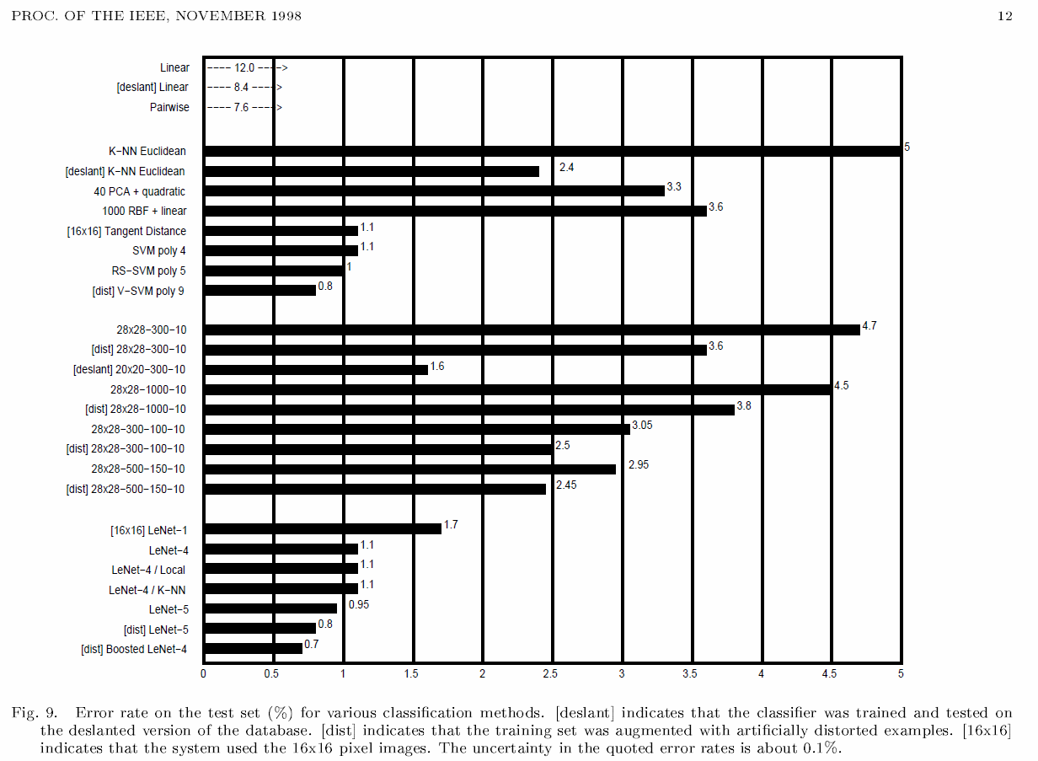
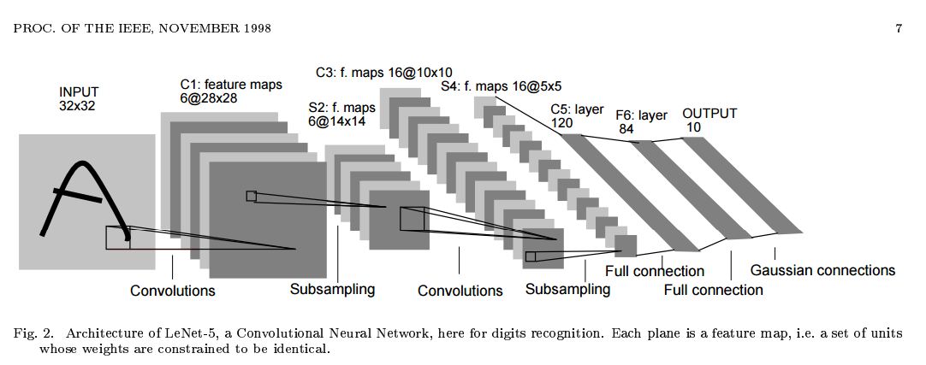
Convolutional Neural Network : Brief History
LeNet-5
Yan Lecun 1998
Error Rate
“The First Convolutional Neural Network”
Gradient-based learning applied to document recognition
Schölkopf, Bernhard, and Alexander J. Smola. Learning with kernels: support vector machines, regularization, optimization, and beyond. MIT press, 2002.
ML Method
Fully Connected Neural Network
CNN

Slide 12
Convolutional Neural Network : Brief History
LeNet-5
Yan Lecun 1998
“The First Convolutional Neural Network”
Gradient-based learning applied to document recognition
Schölkopf, Bernhard, and Alexander J. Smola. Learning with kernels: support vector machines, regularization, optimization, and beyond. MIT press, 2002.
LeNet-5 comprises 7 layers, not counting the input
3 Convolution Layer, 2 Subsampling Layer(pooling Layer), 1 Fully Connected Layer 1 Output Layer
Input -> Conv1(5X5 Filter / stride 1) -> Subsampling1(2X2 Filter / stride 2) -> Conv2(5X5 Filter / stride1 ) -> Subsampling2(2X2 Filter / stride 2) -> Conv3(5X5 Filter / stride1 ) -> FC -> OUTPUT

Slide 13
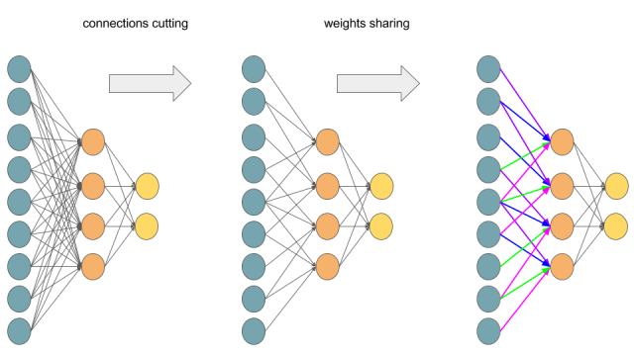
2가지 중요한 Concept
Weight Sharing & Local Connectivity
(Filter)
(Receptive Field)

Slide 14
WHAT?

Slide 15

How to work CNN

Slide 16
INPUT > CONVOLUTION > ACTIVATION FUNCTION > POOLING > FC > OUTPUT
INPUT > Feature Extraction > Shift and Distortion Invariance > Classification > OUTPUT

Slide 17
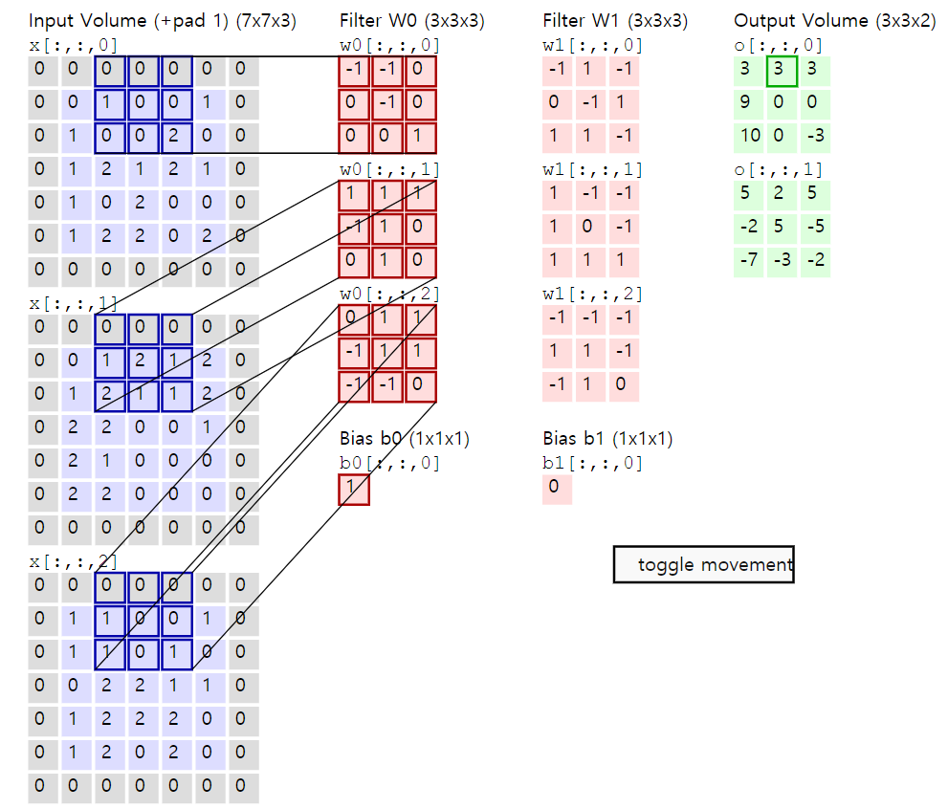
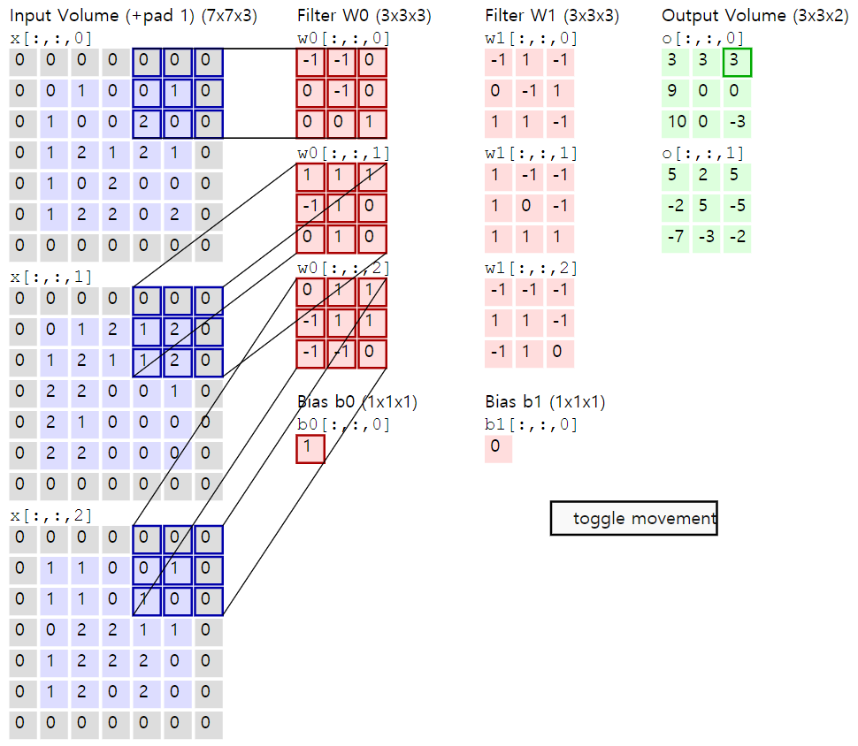
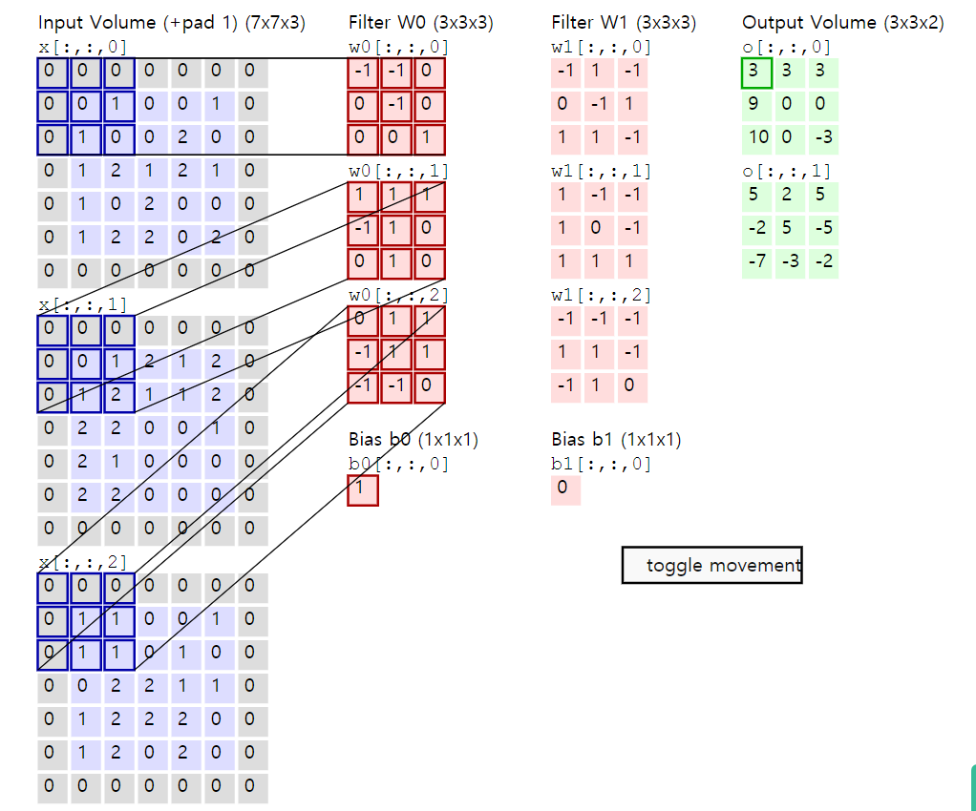
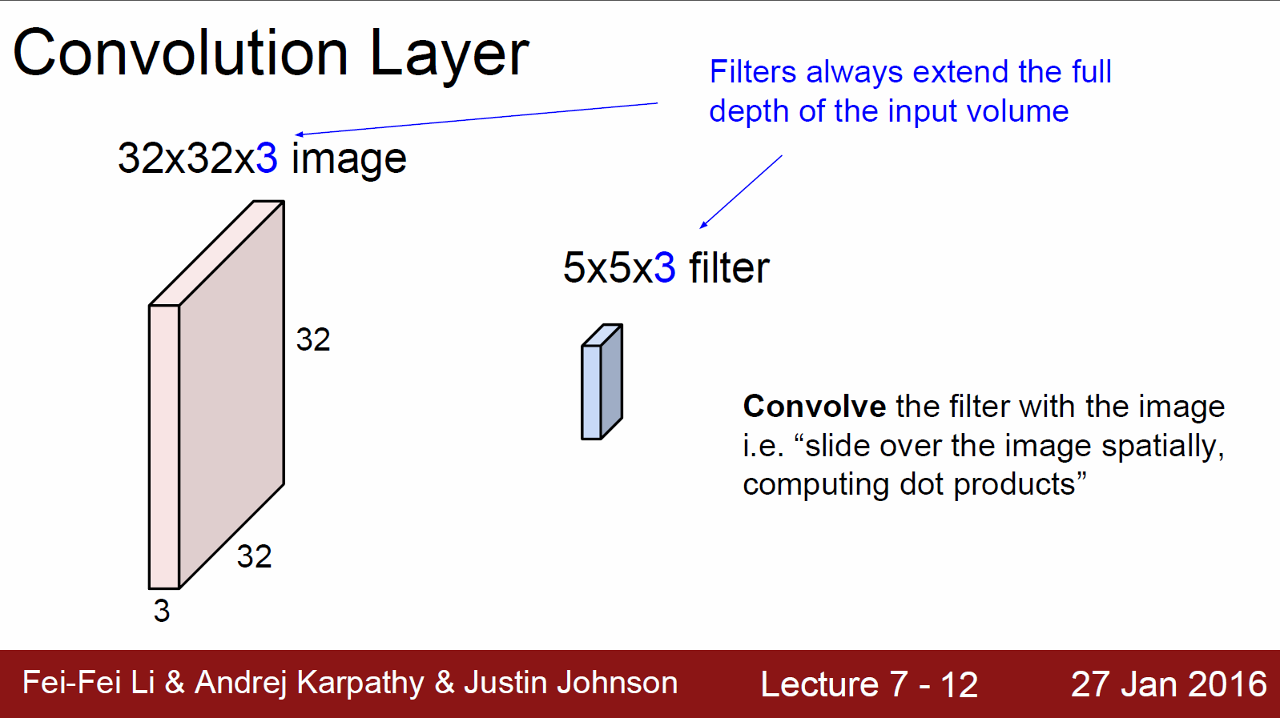
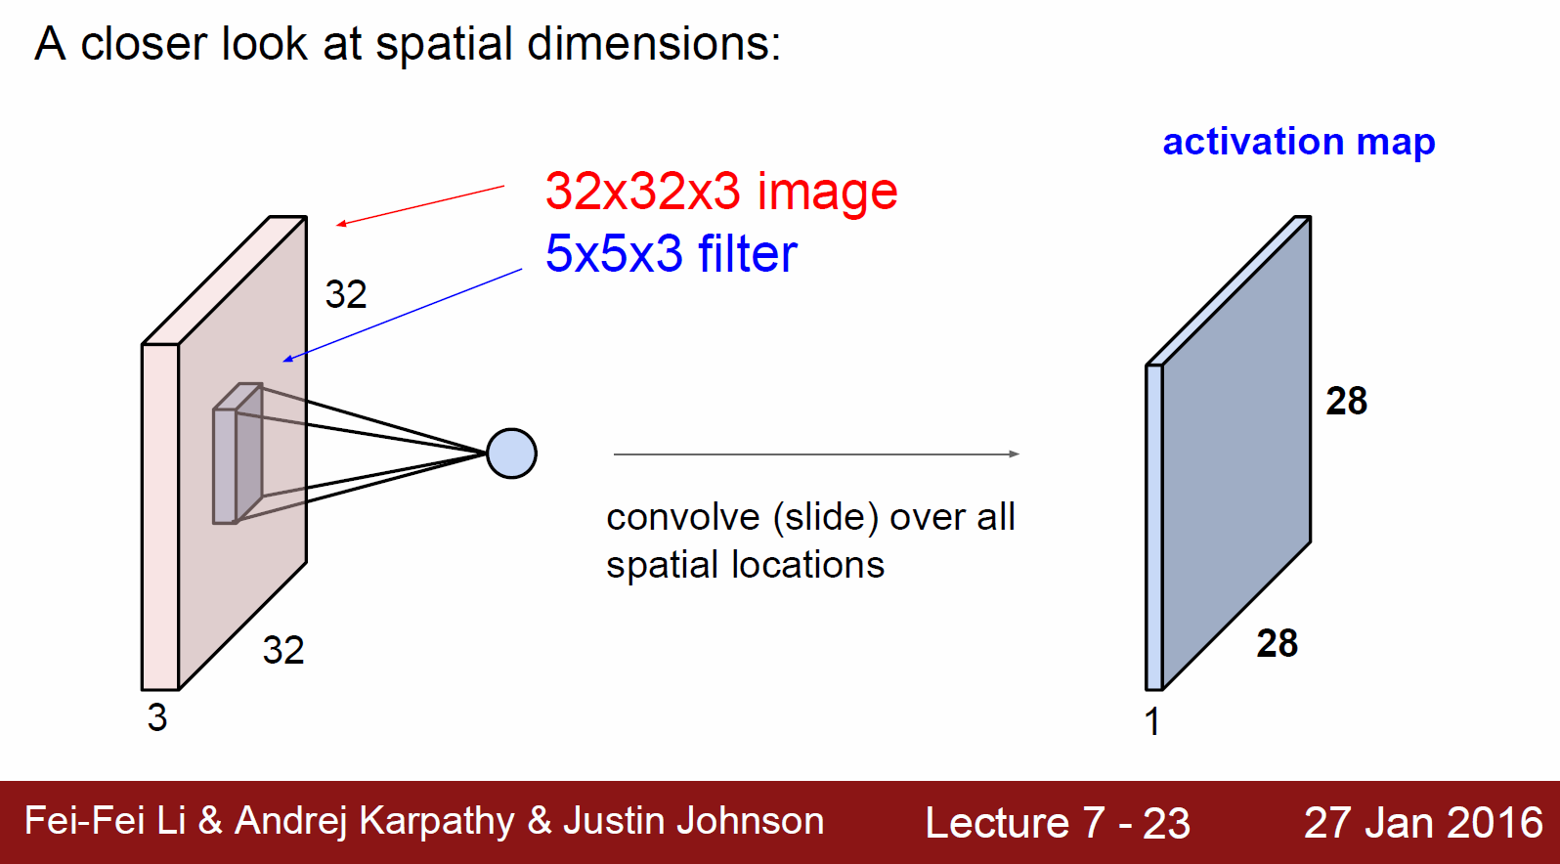

Convolutional Neural Network : How to work
Convolution
Stride = 2!(Hyperparameter)
2칸씩 이동하면서 Slide
Element Wise Multiplication
https://ujjwalkarn.me/2016/08/11/intuitive-explanation-convnets/
Convolution 쉽게 생각하면 “Weighted Moving Sum” (University of Illinois CS 543 수업 Lecture)
https://courses.engr.illinois.edu/cs543/sp2015/lectures/Lecture%2029%20-%20Convolutional%20Neural%20Networks%20-%20%20Vision_Spring2015.pdf
https://deeplearning4j.org/kr/convolutionnets

Slide 18
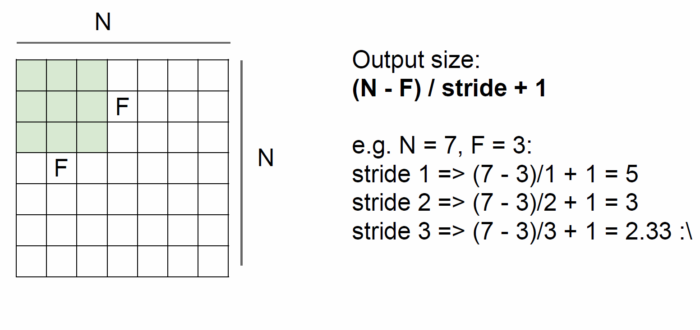
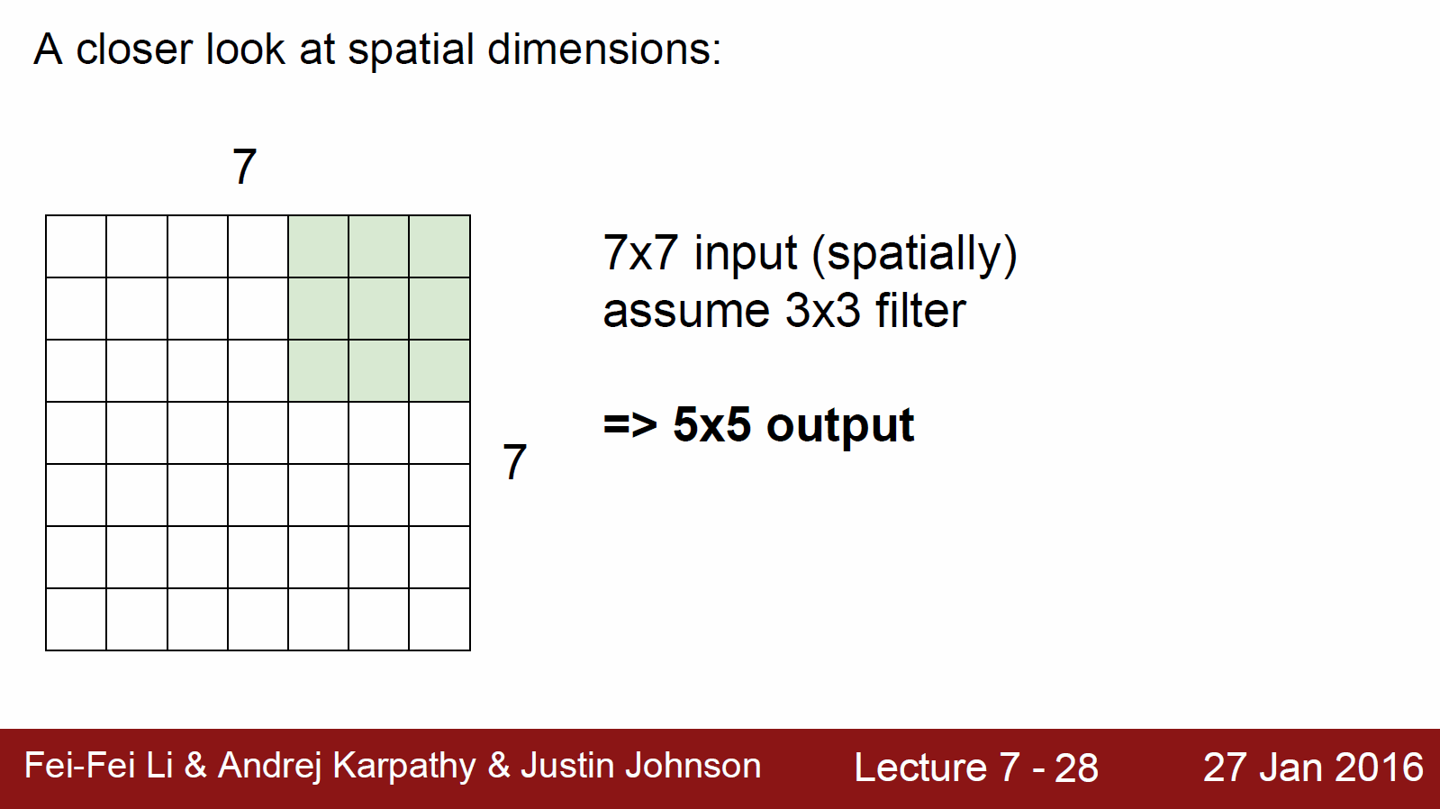
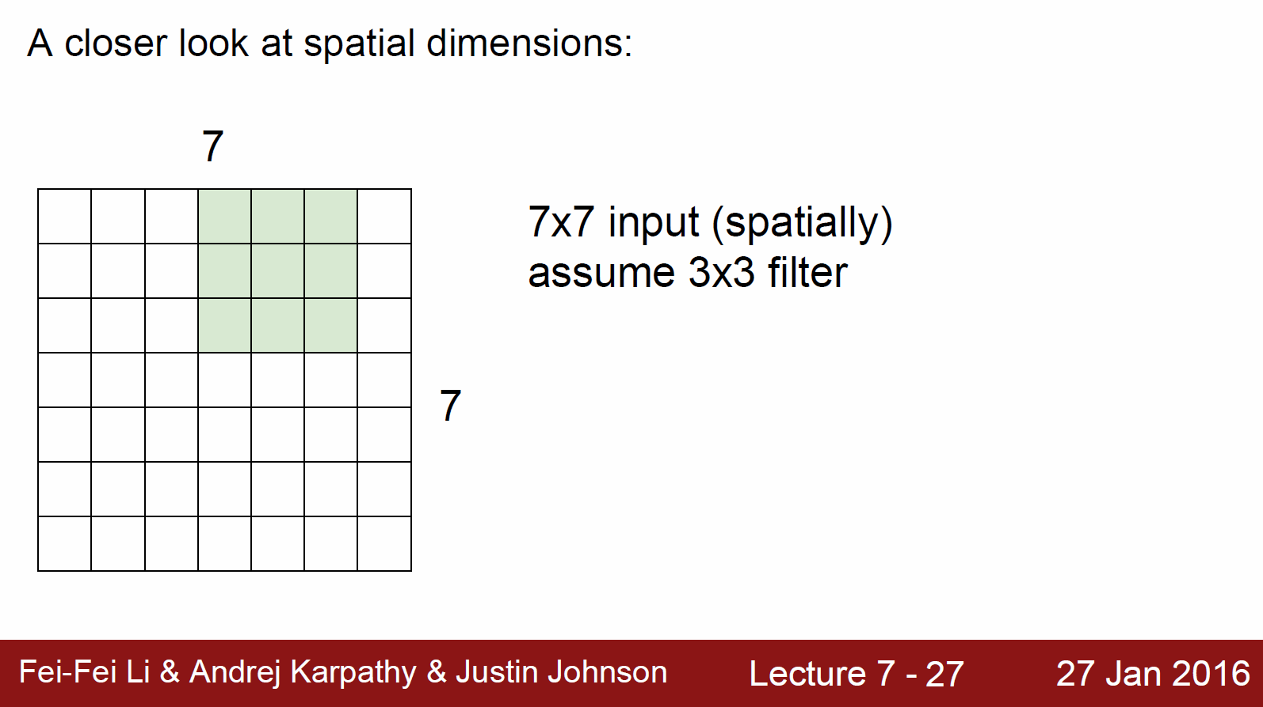
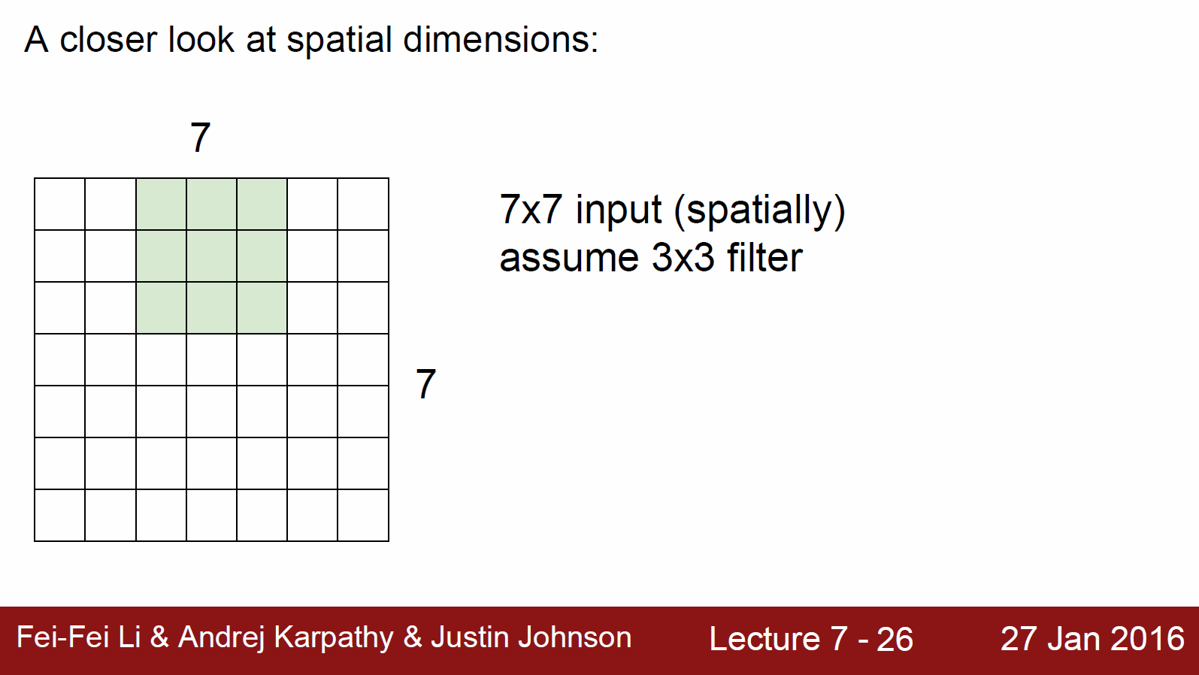
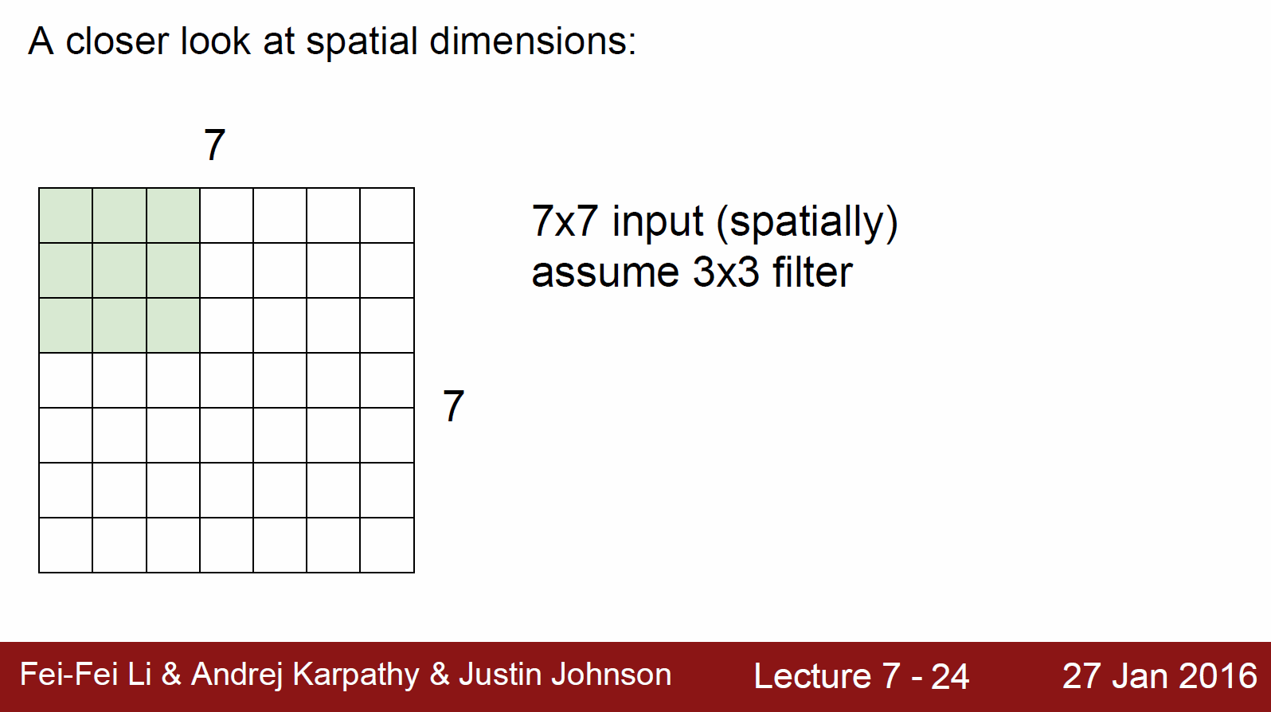
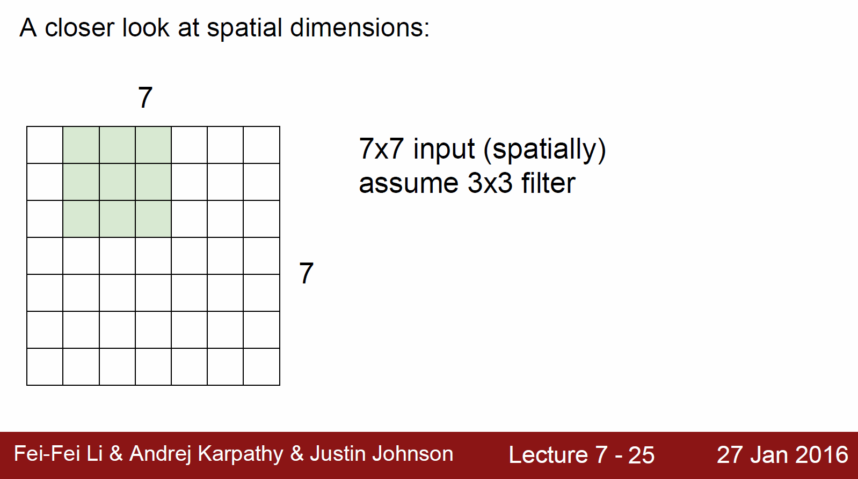
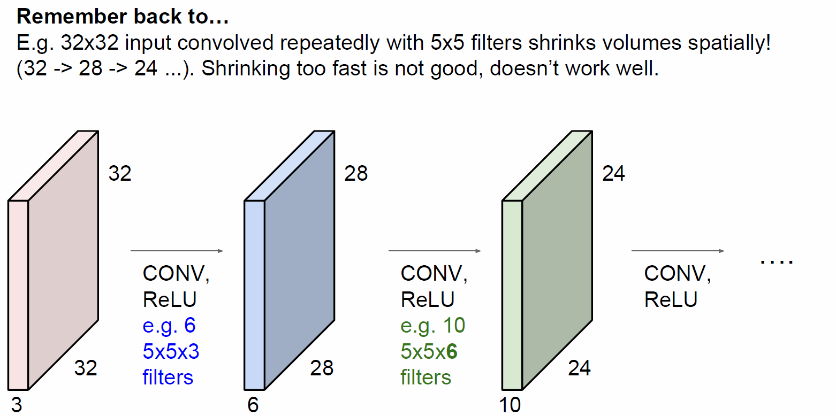
Convolutional Neural Network : How to work
Convolution : Stride = 1
Convolution Layer를 거치게 되면서 점차 이미지의 차원이 축소되어지는 문제점 발생
https://deeplearning4j.org/kr/convolutionnets

Slide 19
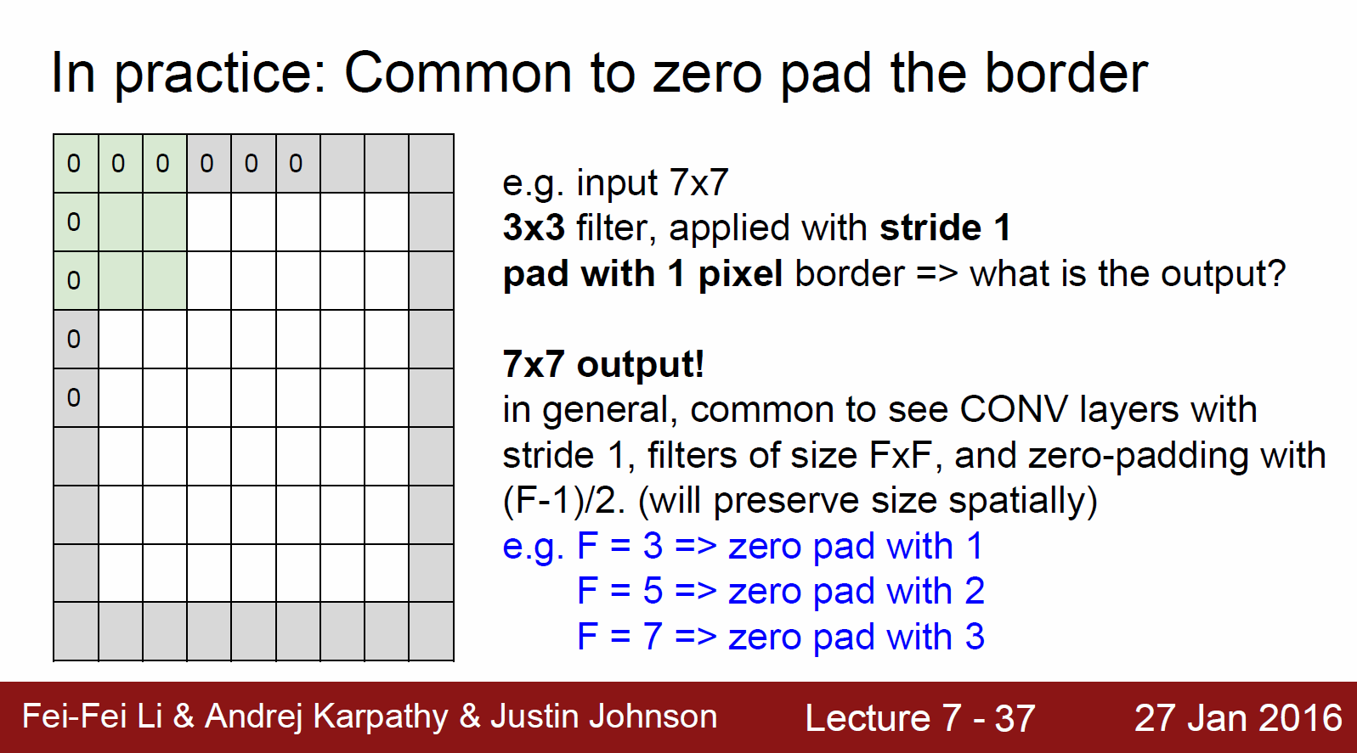
Convolutional Neural Network : How to work
Convolution : padding
Convolution Layer를 거치게 되면서 점차 이미지의 차원이 축소되어지는 문제점 발생
이를 해결하기 위해 Input Data 가장자리에 0의 값을 가지는 pixel을 추가로 구성
Filter 크기에 따라 가장자리에 추가되는 zero pixel의 개수가 달라짐.
단순히 영상의 크기를 유지하는 것 이외에도 경계면의 정보까지 살릴 수 있기때문에 zero padding의 결과가 좀 더 좋게 나타나는 경향. (https://m.blog.naver.com/PostView.nhn?blogId=laonple&logNo=220624485850&proxyReferer=https%3A%2F%2Fwww.google.co.kr%2F)
https://deeplearning4j.org/kr/convolutionnets

Slide 20
Convolution의 개념, Stride, Padding…
?

Slide 21
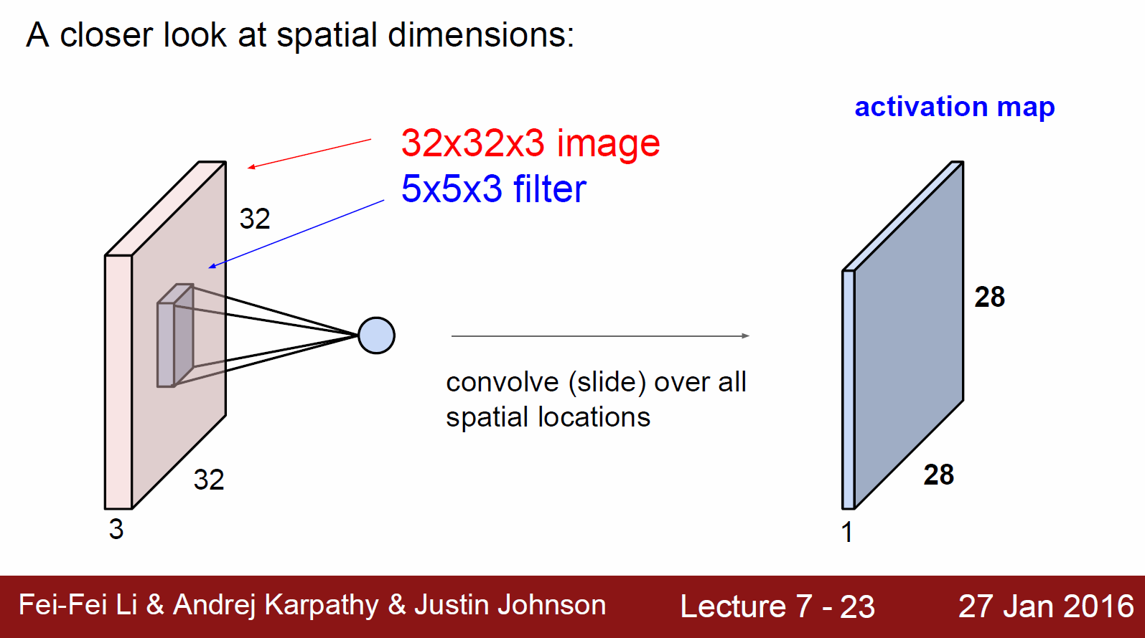
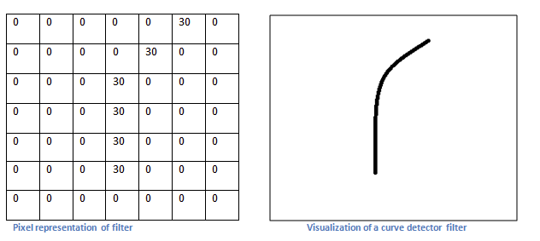
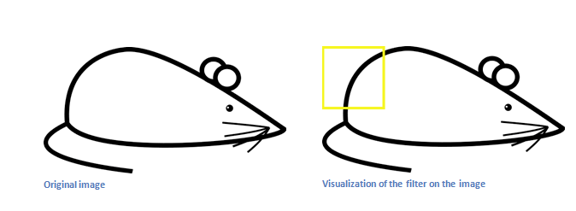
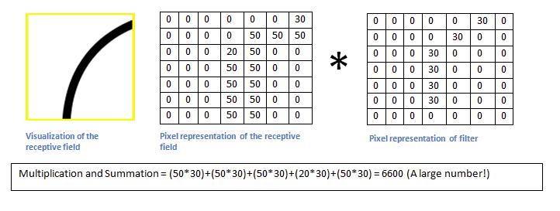
Convolutional Neural Network : How to work
Convolution
Filter를 Convolution하면서 얻어진 activation map?
Example : we have 7X7 Filter
Input Data 곡선에 해당하는 곳에 Filter가 Convolution되면 큰 값이 Return
https://adeshpande3.github.io/adeshpande3.github.io/A-Beginner%27s-Guide-To-Understanding-Convolutional-Neural-Networks/

Slide 22
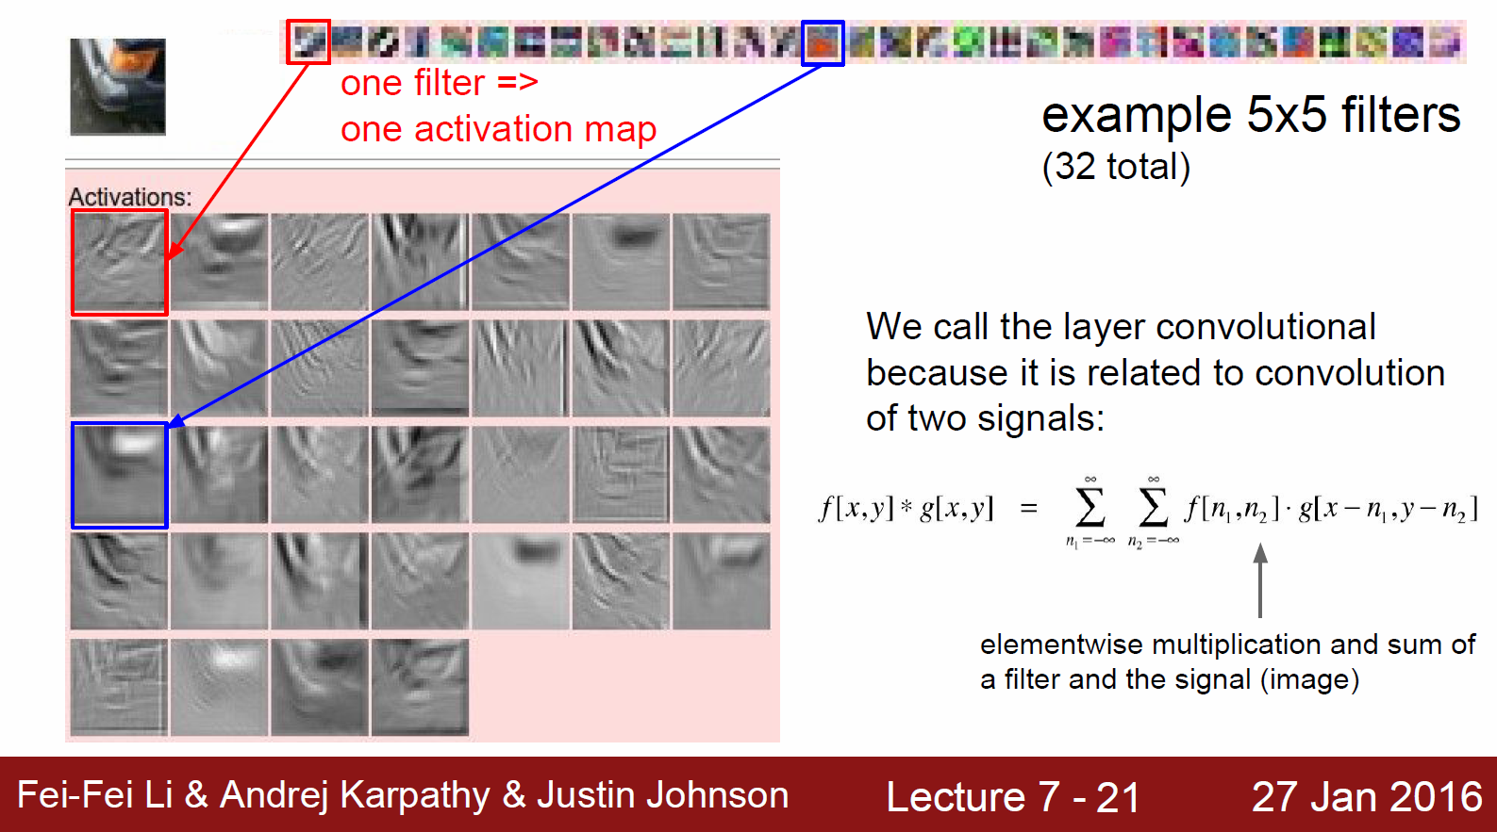
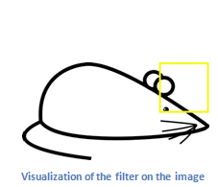
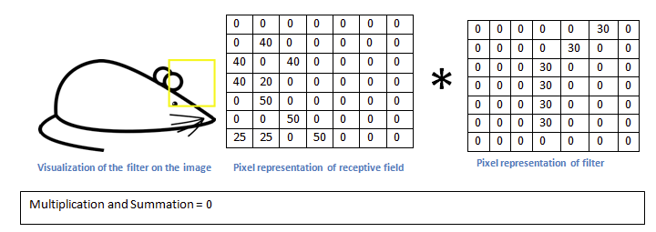
Convolutional Neural Network : How to work
Convolution
Filter를 Convolution하면서 얻어진 activation map?
Convolve
Example : we have 7X7 Filter
Filter와 다른 특징을 가진 수용영역(Receptive Field)에 Convolution 0 Return
https://adeshpande3.github.io/adeshpande3.github.io/A-Beginner%27s-Guide-To-Understanding-Convolutional-Neural-Networks/

Slide 23
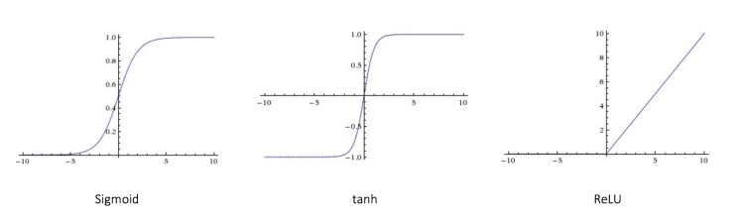

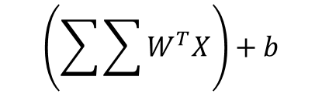
Convolutional Neural Network : How to work
Non-Linearity
Convolution -> linear operation
$$\left(\sum{\sum{W^{T}X}}\right)+b$$
Convolution 계산은 결국 Linear Transform!(Element Wise Multiplication & sum )
Image Pixel의 값을 통한 image Classification은 Non-Linear Problem
Non-Linear 함수인 Sigmoid, Thanh, ReLU …
https://ujjwalkarn.me/2016/08/11/intuitive-explanation-convnets/

Slide 24
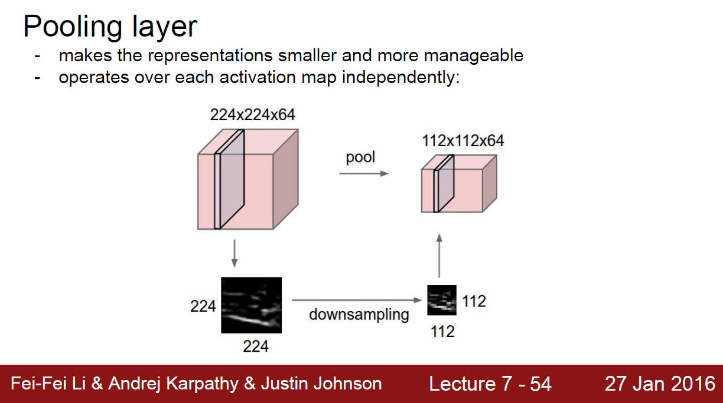
Convolutional Neural Network : How to work
Pooling
Non-Linear Activation Function을 거친 후 Down-Sampling을 통해 정보의 간소화
Pooling에는 다양한 방법들이 존재
: Max Pooling(Popular) Weighted average based on distance L2 norm of neighborhood…
Pooling을 통해서 Translation Invariance를 얻을 수 있다.

Slide 25
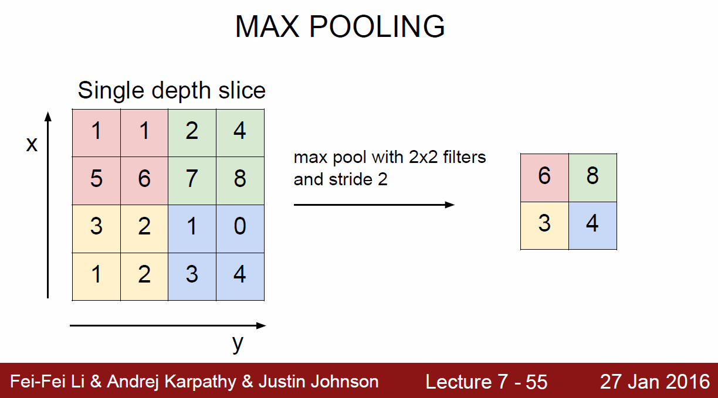
Convolutional Neural Network : How to work
Pooling
Non-Linear Activation Function을 거친 후 Down-Sampling을 통해 정보의 간소화
Pooling에는 다양한 방법들이 존재
: Max Pooling(Popular) Weighted average based on distance L2 norm of neighborhood…
Pooling을 통해서 Translation Invariance를 얻을 수 있다.
Max Pooling의 직관적인 개념은 주변에 Correlation이 있는 여러 Signal에서 가장 강한 Signal만을 사용하겠다는 것. (어떤 특징이 있는지만 알고, 정확한 위나 상세정보는 제거)

Slide 26
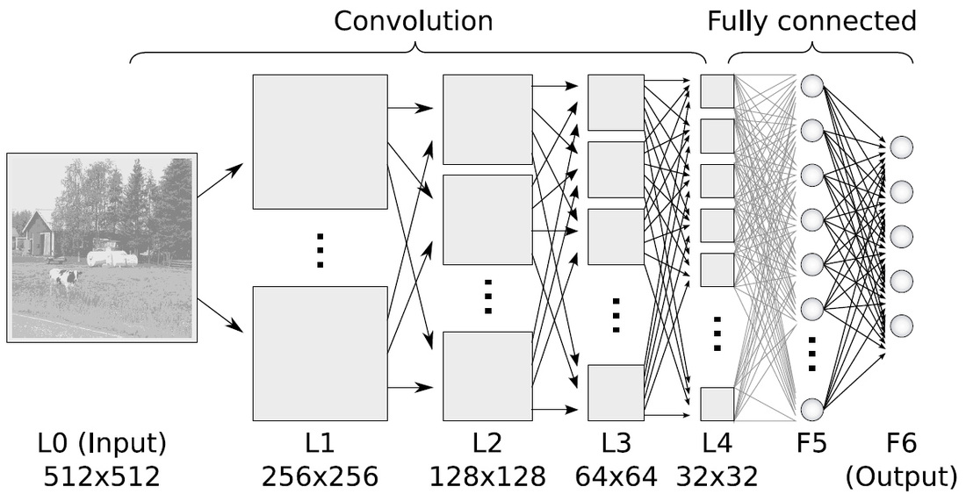
Convolutional Neural Network : How to work
Fully Connected Layer
마지막으로 나오게 된 모든 Activation Map들의 Neurons와 Fully Connected!
Layer 개수 밑 Neurons의 개수는 정해진 정답이 없는 듯?
마지막 Output Layer의 Neuron 개수는 당연하게도 Class의 개수 만큼
Softmax Cross Entropy Function을 통해 Class의 확률 출력

Slide 27
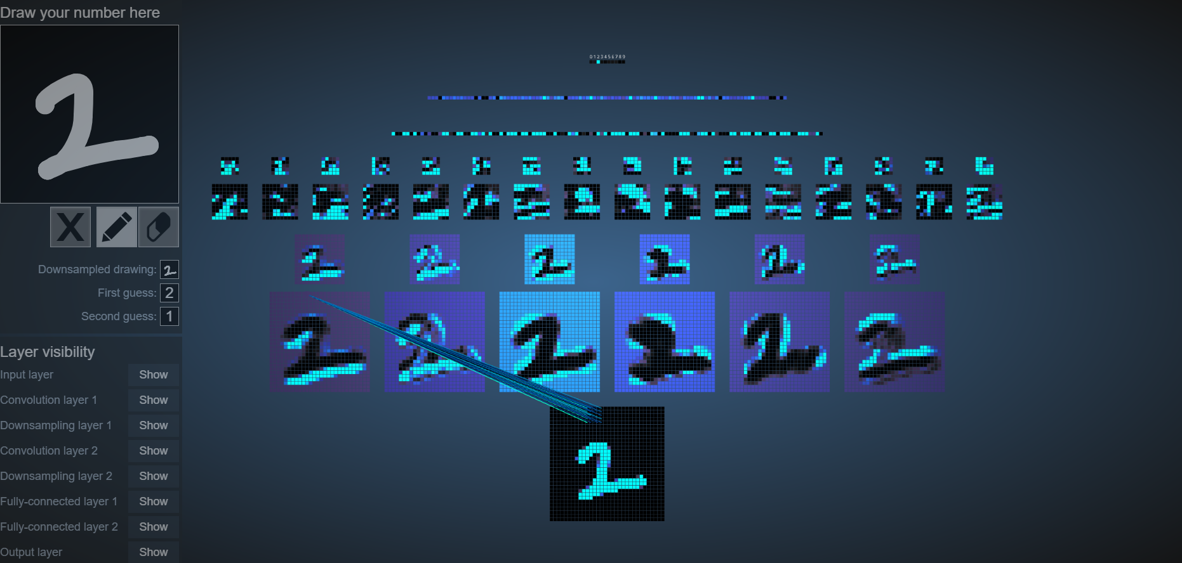
Convolutional Neural Network : How to work
2D Visualization CNN
http://scs.ryerson.ca/~aharley/vis/conv/flat.html

Slide 28
성능을 높이기 위한 다양한 기법
Dropout
Batch Normalization
Other Activation Function… e.g Leaky ReLUs, ELUs…

Slide 29
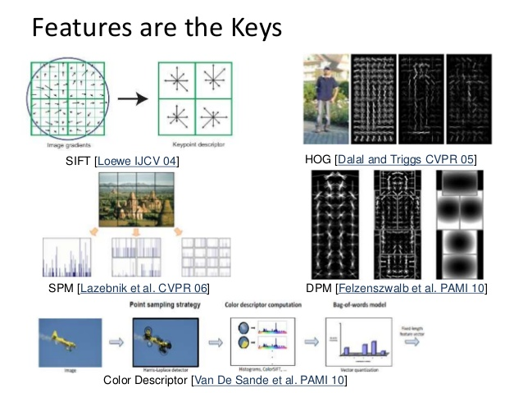
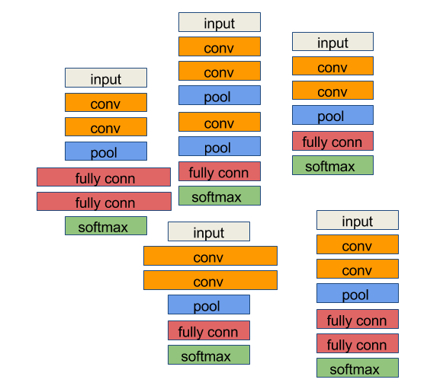
Big Issue
Manual Tuning of Features -> Manual Tuning of Architecture

Slide 30
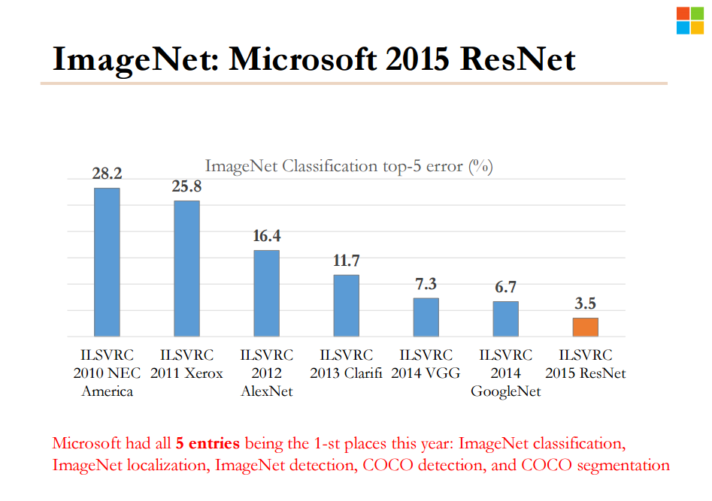
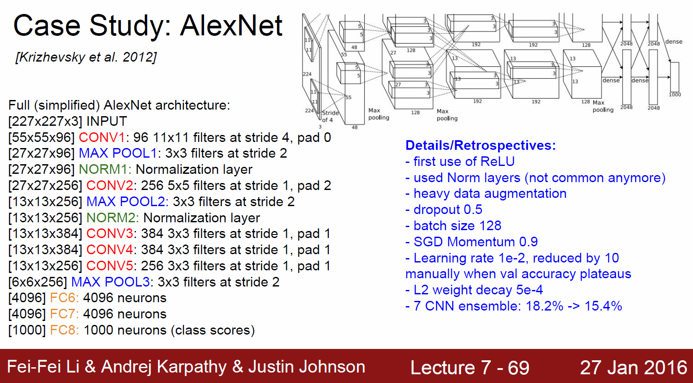
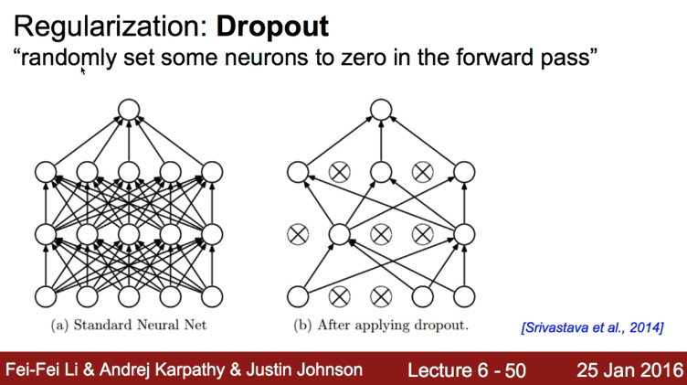
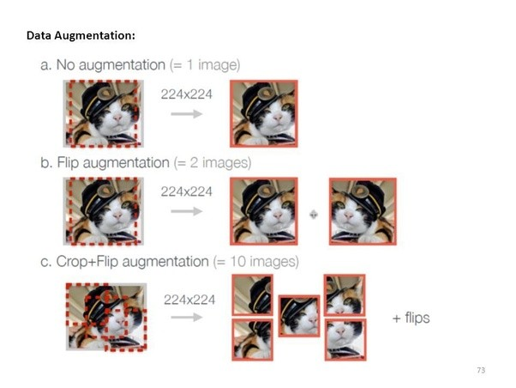
Convolutional Neural Network : Paper
AlexNet (2012)
https://www.bbsmax.com/A/gAJGG0q8JZ/

Slide 31
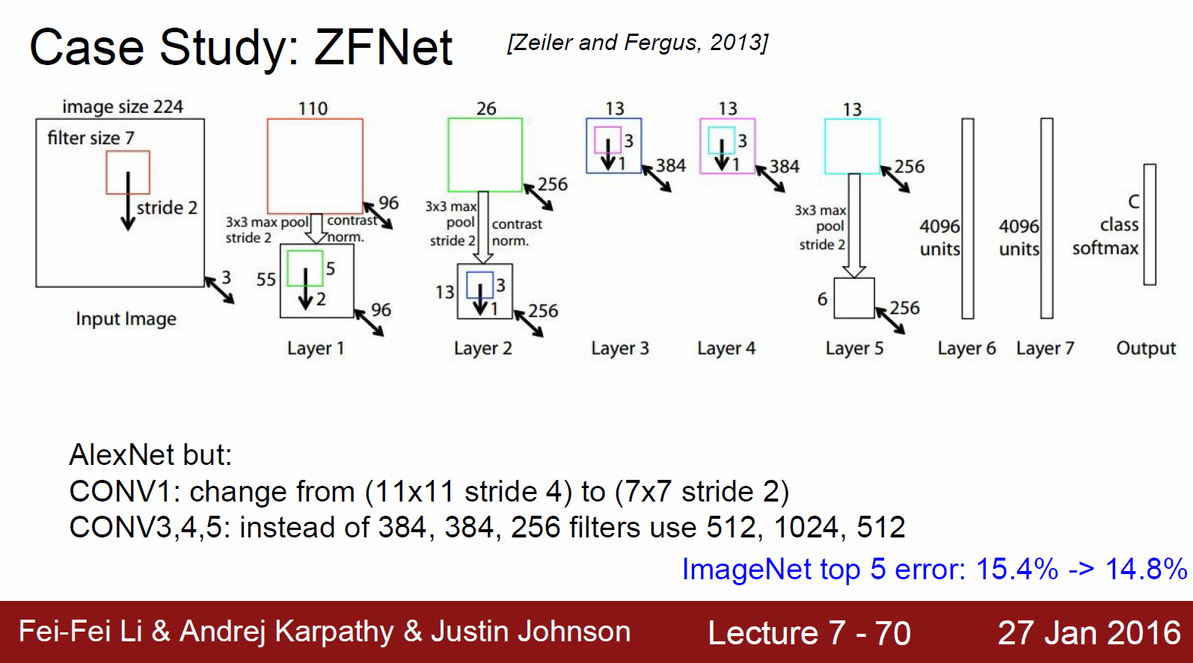
Convolutional Neural Network : Paper
ZFNet (2013)
AlexNet trained on 15 million images, while ZF Net trained on only 1.3 million images.
Instead of using 11x11 sized filters in the first layer (which is what AlexNet implemented), ZF Net used filters of size 7x7 and a decreased stride value.
The reasoning behind this modification is that a smaller filter size in the first conv layer helps retain a lot of original pixel information in the input volume.
Developed a visualization technique named Deconvolutional Network, which helps to examine different feature activations and their relation to the input space. Called “deconvnet” because it maps features to pixels
https://adeshpande3.github.io/adeshpande3.github.io/The-9-Deep-Learning-Papers-You-Need-To-Know-About.html

Slide 32
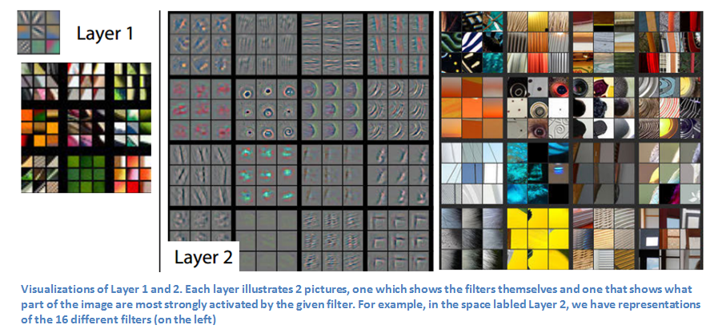
Convolutional Neural Network : Paper
ZFNet (2013)

Slide 33
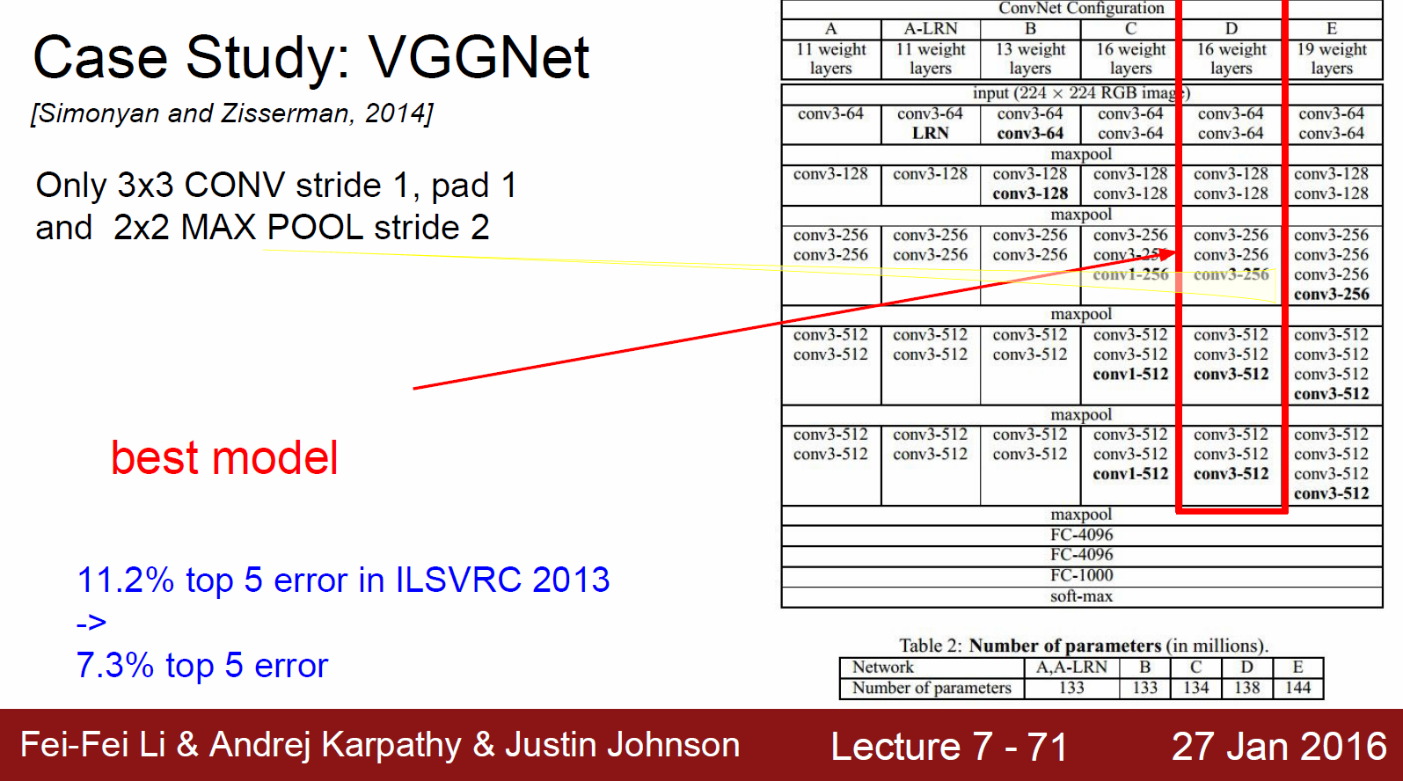
Convolutional Neural Network : Paper
VGGNet (2013)
VGG Net is one of the most influential papers in my mind because it reinforced the notion that convolutional neural networks have to have a deep network of layers in order for this hierarchical representation of visual data to work
https://adeshpande3.github.io/adeshpande3.github.io/The-9-Deep-Learning-Papers-You-Need-To-Know-About.html

Slide 34


Convolutional Neural Network : Brief History
GoogLeNet (2014) & ResNet(2015)
152 Layers…

Slide 35




Convolutional Neural Network : Brief History
DenseNet(2016)

Slide 36
Convolutional Neural Network (CNN)
QnA

